Slide 1
Elementary
These slides are most suitable for grades 4-6

Slide 2
Renewable Energy

Slide 3
Answer these questions…
What is Energy?
What types of Energy are there?
What’s your favorite type of Energy?

Slide 4
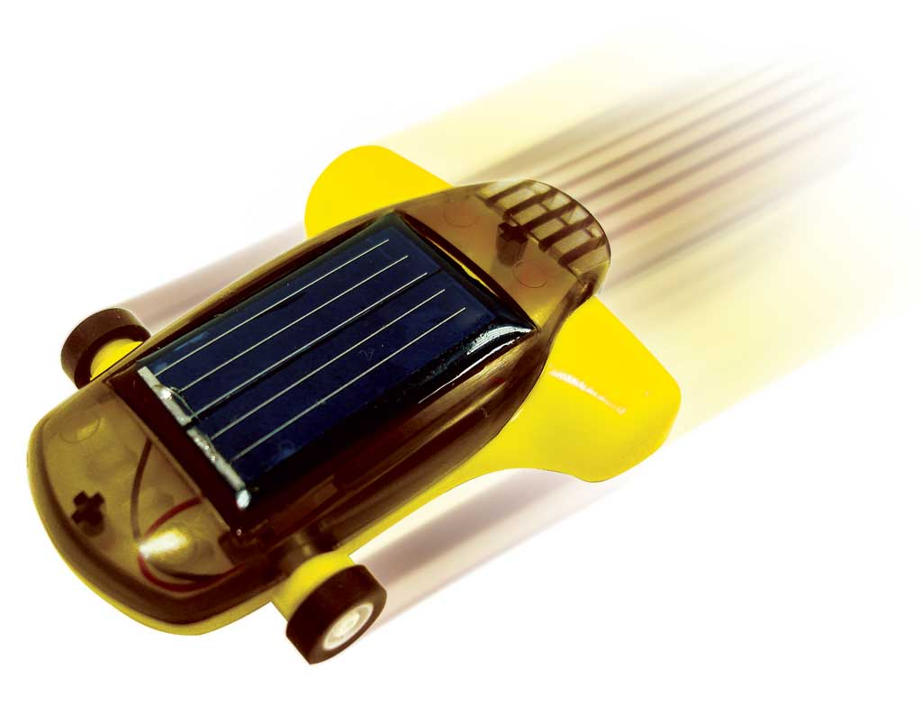
Let’s talk about some of the more common (and visible forms) of energy
Kinetic Energy
Where have you seen this?
Wind Turbines
Nozzles and Diffusers
Potential Energy
Where have you seen this?
Pumps
Hydroelectric Plants

Slide 5

Kinetic Energy
Energy that a system or body has because it is in motion, is called kinetic energy (KE).
Energy associated with mass(kg) and velocity(m/s)!
$KE=m\frac{V^{2}}{2}$ (kJ)

Slide 6
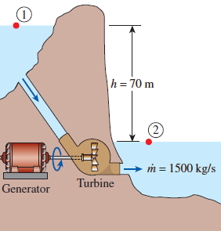
Potential Energy
This is the energy that a system has because of elevation
The water on one side of the hill is higher than on the other. That means the water on the left has Potential Energy that could be used.
Someone put a Turbine in between the two sides to capture some of that energy
$PE=m∗g∗h$ (kJ)
$$m=mass$$
g= gravitational constant (9.81 m/s²)
h = is the height relative to a reference point

Slide 8
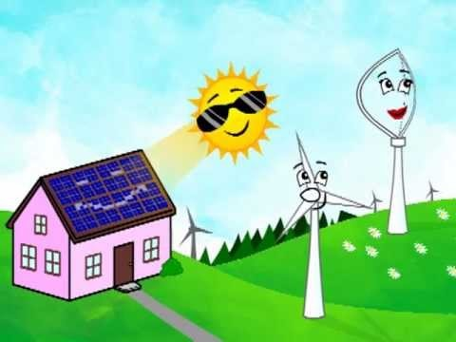

Slide 10
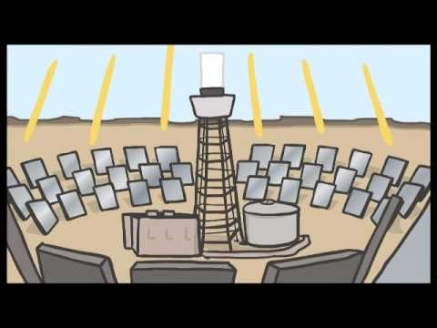

Slide 11
Remember…
Mass = Kilograms (kg)
Volume = Meters Cubed (m^3)
Distance = Meters (m)
Velocity = Meters per Second (m/s)
Accelerations = Meters per Second Squared (m/s^2)
Energy = Joules (kJ)
Power = Watts (W)

Slide 12
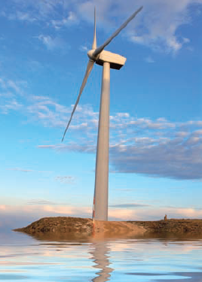
Wind Energy Example Problem
Winds blow at a speed of 16 m/s on a wind turbine.
What’s the amount of power that could come out of the turbine?
We’ll say that 2170 kg/s of air passes through the big turbine.

Slide 13
Solution
The mass flow of air in the system is:
The wind speed is:
Our Kinetic Energy formula is:
$$m=2170 kg/s$$
$$That^{′}s enough power to run 9 houses,$$
$$that^{′}s pretty good considering wind is free!$$
$$V=16 m/s$$
$$KE=\frac{1}{2}mV^{2}=\frac{1}{2} x 2170 x {16}^{2}=277,760 W$$

Slide 14
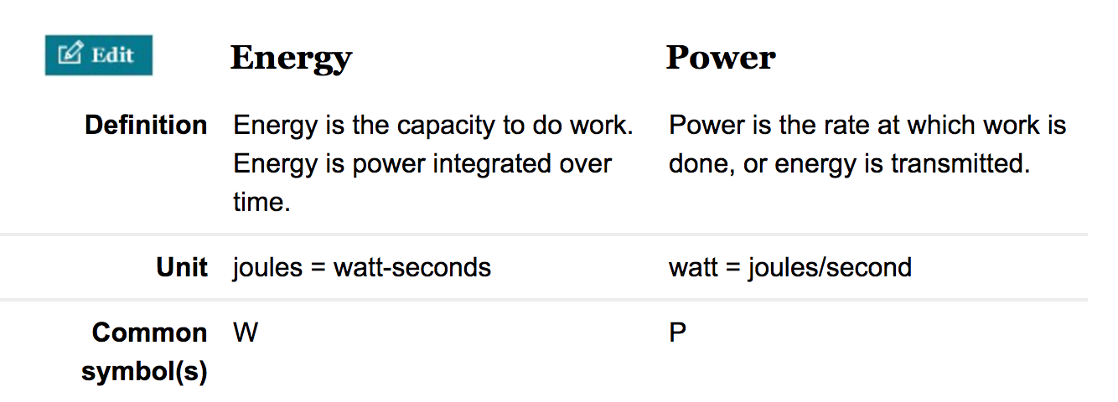
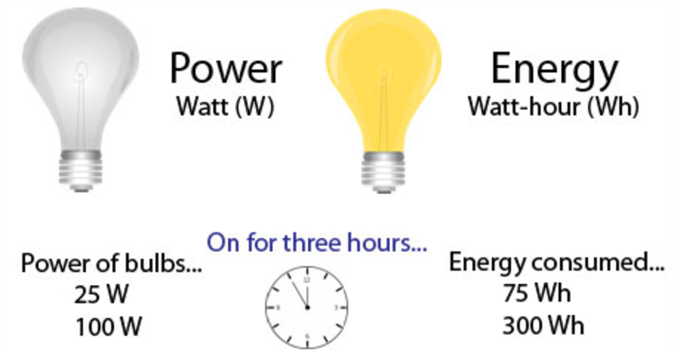
Solution
Real Wind Turbines convert about one-third of this potential to electric power
The mass flow of air in the system is:
The wind speed is:
Our Kinetic Energy formula is:
$$m=2170 kg/s$$
$$V=16 m/s$$
$$KE=\frac{1}{2}mV^{2}=\frac{1}{2} x 2170 x {16}^{2}=277,760 W$$

